Slide 1
Analysis of Fire Fighting Methods using Cellular Automaton Modeling
Matthew Wilson, Brent D. Foy
Notes:
Put on physics department and psychology department

Slide 2
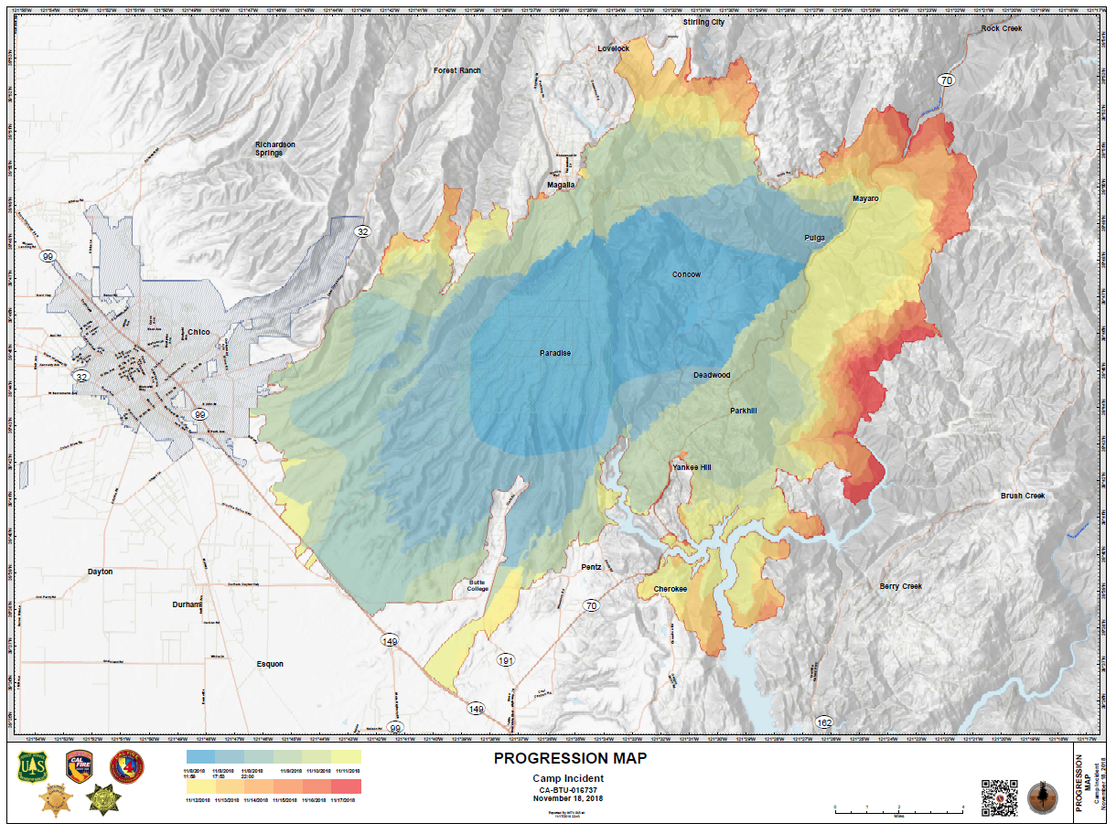
Forest Fires and their Effects
Camp Fire Wildfire
Destroyed over 150,000 acers
85 civilian deaths (2018) [1]

Slide 3
Cellular Automaton
Made up of a grid of cells
Simulates interactions between closest cells
Most known example is Conway’s Game of Life

Slide 4
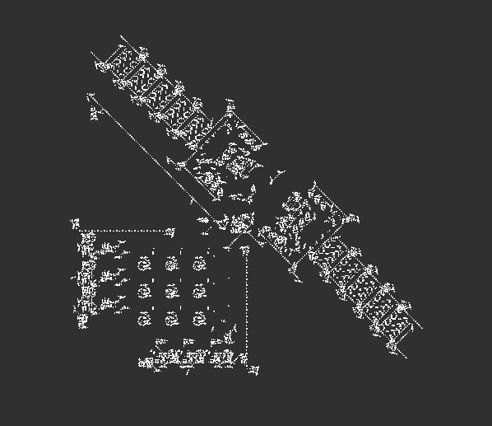
Conway's Game of Life
Three Rules
A live cell survives if it has two or three live neighbors
A new cell is born whenever there are three live neighbors
All other cells either die or remain inactive
“Glider”
Turing machine
[3]

Slide 5
2D Convolution
Takes a matrix
Slides kernel over matrix
Kernel is usually a smaller matrix
Zero padded for same size
[2]

Slide 6
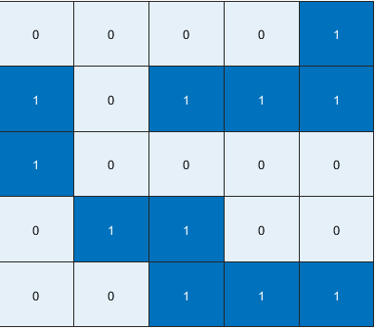
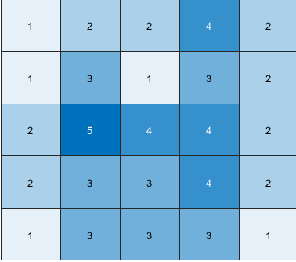
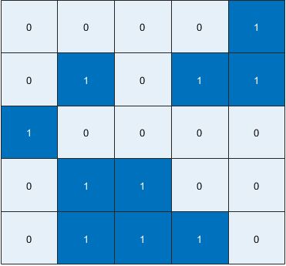
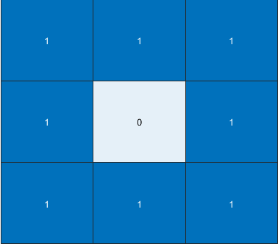
Game of Life Convolution
Kernel
2D Convolution
Initial Game of Life Board
New Board

Slide 7
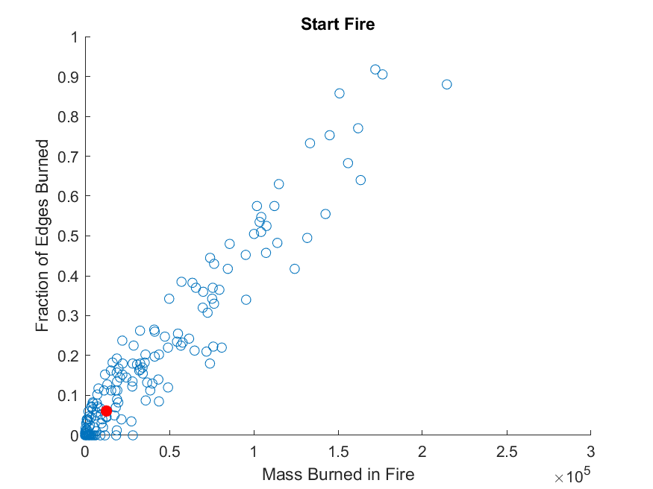
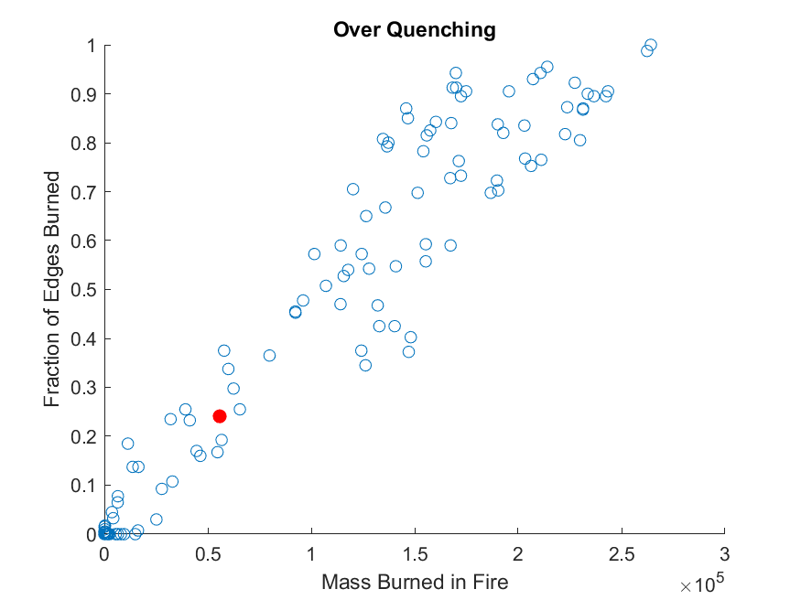
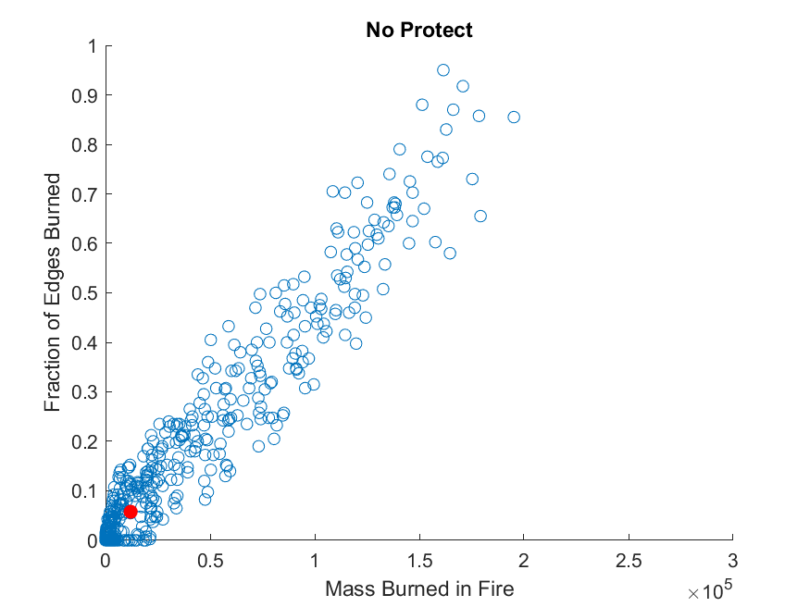
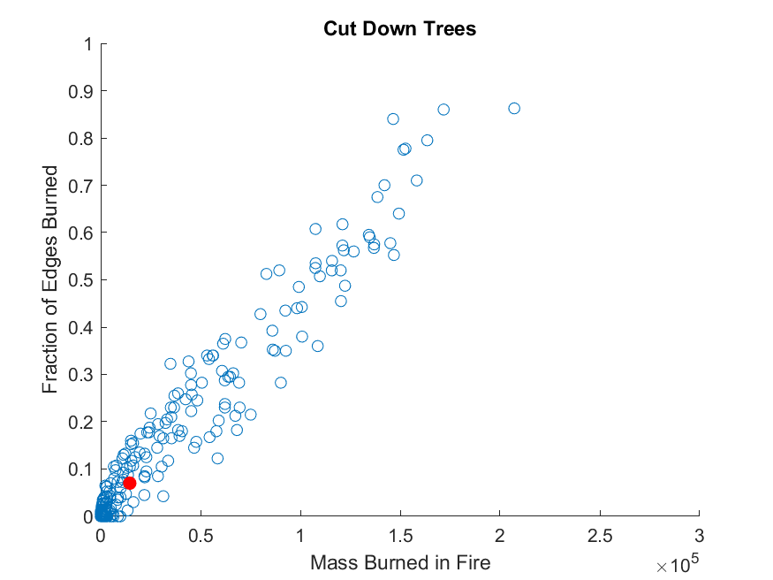
Graphs

Slide 8
References
[1] Camp Fire Final report (2018)
[2] https://towardsdatascience.com/types-of-convolutions-in-deep-learning-717013397f4d
[3] A. Adamatzky, Game of Life cellular automata. [electronic
resource]. (Springer, 2010).

